Slide 1

2018 Seminar on Predictive Modeling: Predictive Modeling Basics
Jeffrey Strickland, Ph.D., CMSP, ASEP
CEO Humalytica Analytics
Proprietor Simulation Educators

Slide 2
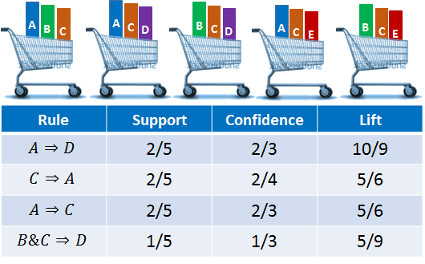
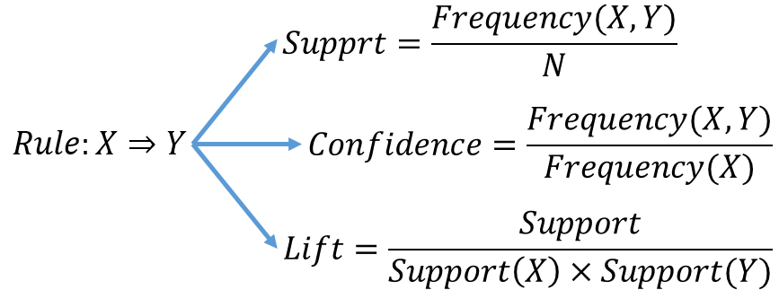
Market Basket Analysis
Association Rules
SETM (Set Oriented Mining) Algorithm
Apriori Algorithm
AprioriTid Algorithm
AprioriHybrid Algorithm
R-package – “Visualizing Categorical Data” (vcd)

Slide 3
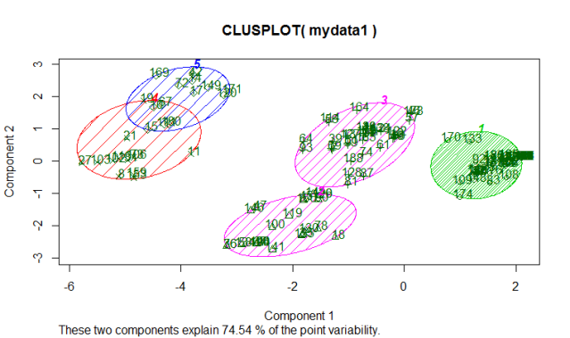
Cluster Analysis
Plant and animal ecology
Human genetic clustering
Medical imaging
Market research
Social network analysis
Software evolution
Crime analysis
Cyber attack analysis
Petroleum geology

Slide 4



Propensity Models
What are they?
Propensity to buy
Propensity to use
Propensity to engage
Propensity to contact
Propensity to churn
Propensity to shed
Etc.
R-Package – Generalized Linear Models (glm and Glm)
Where are they used?
Life Insurance
Auto Insurance
Homeowner’s Insurance
Mortgage
Re-Financing
Credit cards
Personal Loans
Investments
Satellite TV
Cable
Netflix
Online banking
Online money management
Voting
Disease

Slide 5
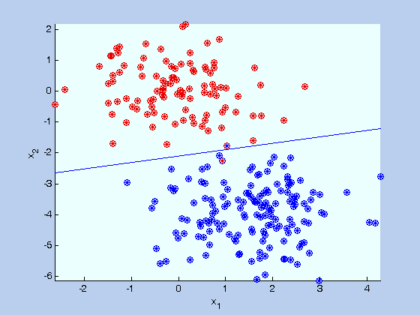
Propensity models
Logistic regression
Modeling assumptions
One dependent variable
Target variable/response is binary
Yes or no
1 or 0
One to many independent variables
Parametric
Log-linear functional assumption

Slide 6

Propensity to buy a new mortgage
Homebuyer model
Buy a new home within next 3 months
Acquisition window = 3 months
Preprocessing period = 3 months
Profile window = 1 year
Target Data
Homeowner data by county
Compiled monthly
SAS/SPSS/etc. database
Independent variables
1 to 20 customer databases
Up to 2000 variable
Up to 20 million records

Slide 7
Model Performance
These are the modeled response rates (train & validate)
This is the random response rate

Slide 8

Margin Call (2011)

Slide 9

Economic Evaluation
Assumptions
5-Year NPV = $1,500.00 (approximate)
Cost per direct mail = $0.50 (approximate)
Evaluated by pentile
About 10 million customers

Slide 10
Economic Evaluation
Cost of Mail | $ 0.50 |  |  | Direct Mail |  |  |  |  |  |  |  | Net Profit with Model |  |  | Net Profit without Model
NVP | $ 1,500.00 |  |  | Total Mailed | Acq |  | Cost per Acq |  | Incremental Revenue due to Model | Total Mail Cost with No Model | Total Mail Cost with Model | PTI | Net Profit | Cum Net Profit with Model | PTI | Net Profit | Cum Net Profit No Model | Net Profit Difference | Cum Net Profit Difference
Mailed Pop | Resp Rate | Cum Resp Rate |  |  | No Model | With Model | No Model | With Model
5% | 2.97% | 2.97% |  | 150000 | 1437 | 4457 | $ 46.96 | $ 15.14 | $ 5,408,837 | $ 67,500.00 | $ 1,992.71 | $ 7,930,990 | $ 7,928,998 | $ 7,928,998 | $ 2,574,361 | $ 2,506,861 | $ 2,506,861 | $ 5,422,136 | $ 5,422,136
10% | 2.17% | 5.14% |  | 150000 | 1437 | 3255 | $ 46.96 | $ 20.74 | $ 3,254,726 | $ 67,500.00 | $ 1,496.75 | $ 5,957,071 | $ 5,955,574 | $13,884,572 | $ 2,574,361 | $ 2,506,861 | $ 5,013,723 | $ 3,448,712 | $ 8,870,849
15% | 1.58% | 6.72% |  | 150000 | 1437 | 2363 | $ 46.96 | $ 28.56 | $ 1,658,568 | $ 67,500.00 | $ 1,110.86 | $ 4,421,203 | $ 4,420,092 | $18,304,665 | $ 2,574,361 | $ 2,506,861 | $ 7,520,585 | $ 1,913,230 | $10,784,079
20% | 1.35% | 8.07% |  | 150000 | 1437 | 2031 | $ 46.96 | $ 33.24 | $ 1,062,658 | $ 67,500.00 | $ 906.44 | $ 3,607,637 | $ 3,606,731 | $21,911,396 | $ 2,574,361 | $ 2,506,861 | $ 10,027,447 | $ 1,099,869 | $11,883,949
25% | 1.25% | 9.32% |  | 150000 | 1437 | 1872 | $ 46.96 | $ 36.06 | $ 778,410 | $ 67,500.00 | $ 803.56 | $ 3,198,152 | $ 3,197,349 | $25,108,745 | $ 2,574,361 | $ 2,506,861 | $ 12,534,309 | $ 690,4878 | $12,574,436
30% | 1.00% | 10.31% |  | 150000 | 1437 | 1494 | $ 46.96 | $ 45.19 | $ 101,127 | $ 67,500.00 | $ 730.12 | $ 2,905,897 | $ 2,905,167 | $28,013,913 | $ 2,574,361 | $ 2,506,861 | $ 15,041,171 | $ 398,305 | $12,972,741
35% | 0.99% | 11.30% |  | 150000 | 1437 | 1481 | $ 46.96 | $ 45.58 | $ 78,195 | $ 67,500.00 | $ 676.64 | $ 2,693,014 | $ 2,692,337 | $30,706,250 | $ 2,574,361 | $ 2,506,861 | $ 17,548,033 | $ 185,475 | $13,158,217
40% | 0.90% | 12.20% |  | 150000 | 1437 | 1349 | $ 46.96 | $ 50.05 | $ (158,801) | $ 67,500.00 | $ 626.62 | $ 2,493,949 | $ 2,493,322 | $33,199,573 | $ 2,574,361 | $ 2,506,861 | $ 20,054,894 | $ (13,539) | $13,144,678
45% | 0.87% | 13.07% |  | 150000 | 1437 | 1307 | $ 46.96 | $ 51.65 | $ (233,710) | $ 67,500.00 | $ 598.28 | $ 2,381,142 | $ 2,380,544 | $35,580,117 | $ 2,574,361 | $ 2,506,861 | $ 22,561,756 | $ (126,317) | $13,018,360
50% | 0.81% | 13.89% |  | 150000 | 1437 | 1222 | $ 46.96 | $ 55.22 | $ (384,977) | $ 67,500.00 | $ 554.53 | $ 2,207,035 | $ 2,206,481 | $37,786,598 | $ 2,574,36 | $ 2,506,861 | $ 25,068,618 | $ (300,380) | $12,717,980
55% | 0.77% | 14.65% |  | 150000 | 1437 | 1150 | $ 46.96 | $ 58.69 | $ (514,643) | $ 67,500.00 | $ 513.98 | $ 2,045,626 | $ 2,045,112 | $39,831,711 | $ 2,574,361 | $ 2,506,861 | $ 27,575,480 | $ (461,748) | $12,256,231
60% | 0.66% | 15.32% |  | 150000 | 1437 | 992 | $ 46.96 | $ 68.06 | $ (798,125) | $ 67,500.00 | $ 483.64 | $ 1,924,892 | $ 1,924,408 | $41,756,120 | $ 2,574,361 | $ 2,506,861 | $ 30,082,342 | $ (582,453) | $11,673,778
65% | 0.70% | 16.01% |  | 150000 | 1437 | 1045 | $ 46.96 | $ 64.59 | $ (702,743) | $ 67,500.00 | $ 453.90 | $ 1,806,534 | $ 1,806,080 | $43,562,201 | $ 2,574,361 | $ 2,506,861 | $ 32,589,204 | $ (700,781) | $10,972,996
70% | 0.64% | 16.65% |  | 150000 | 1437 | 963 | $ 46.96 | $ 70.09 | $ (849,502) | $ 67,500.00 | $ 420.14 | $ 1,672,147 | $ 1,671,727 | $45,233,928 | $ 2,574,361 | $ 2,506,861 | $ 35,096,066 | $ (835,134) | $10,137,862
75% | 0.63% | 17.29% |  | 150000 | 1437 | 949 | $ 46.96 | $ 71.15 | $ (875,309) | $ 67,500.00 | $ 386.76 | $ 1,539,307 | $ 1,538,920 | $46,772,849 | $ 2,574,361 | $ 2,506,861 | $ 37,602,928 | $ (967,940) | $ 9,169,921
80% | 0.48% | 17.76% |  | 150000 | 1437 | 716 | $ 46.96 | $ 94.33 | $(1,292,708) | $ 67,500.00 | $ 349.63 | $ 1,391,542 | $ 1,391,193 | $48,164,042 | $ 2,574,361 | $ 2,506,861 | $ 40,109,789 | $(1,115,668) | $ 8,054,252
85% | 0.48% | 18.25% |  | 150000 | 1437 | 724 | $ 46.96 | $ 93.27 | $(1,278,218) | $ 67,500.00 | $ 312.11 | $ 1,242,186 | $ 1,241,873 | $ 49,405,916 | $ 2,574,361 | $ 2,506,861 | $ 42,616,651 | $(1,264,987) | $ 6,789,264
90% | 0.41% | 18.65% |  | 150000 | 1437 | 611 | $ 46.96 | $110.47 | $(1,479,972) | $ 67,500.00 | $ 272.76 | $ 1,085,577 | $ 1,085,305 | $50,491,221 | $ 2,574,361 | $ 2,506,861 | $ 45,123,513 | $(1,421,556) | $ 5,367,707
95% | 0.31% | 18.96% |  | 150000 | 1437 | 463 | $ 46.96 | $145.73 | $(1,744,789) | $ 67,500.00 | $ 224.93 | $ 895,234. | $ 895,009 | $51,386,230 | $ 2,574,361 | $ 2,506,861 | $ 47,630,375 | $(1,611,852) | $ 3,755,855
100% | 0.20% | 19.17% |  | 150000 | 1437 | 304 | $ 46.96 | $221.68 | $(2,029,022) | $ 67,500.00 | $ 154.29 | $ 614,094. | $ 613,939 | $52,000,170 | $ 2,574,361 | $ 2,506,861 | $ 50,137,237 | $(1,892,922) | $ 1,862,933
Mail to top 35% or 1st through 7th Pentile

Slide 11
Economic Evaluation

Slide 12
Economic Evaluation

Slide 13
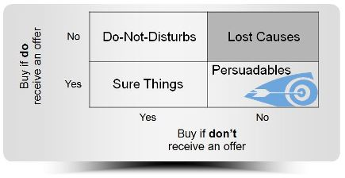
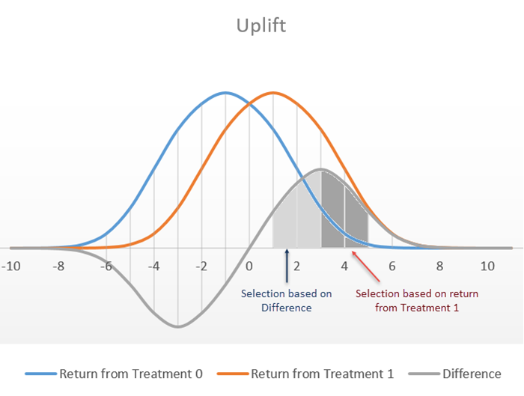
Net Lift (Uplift) Modeling
What is the incremental gain in auto loans when customers receive an offer?
Test Group – Gets Offer
Control Group – Does not get Offer
Net Lift = Treated(RESP) – Control(RESP)
Control(RESP) = Sure Things
Weeds out the lift generated by the “Sure Things”
R-package – randomForest (rf)

Slide 14
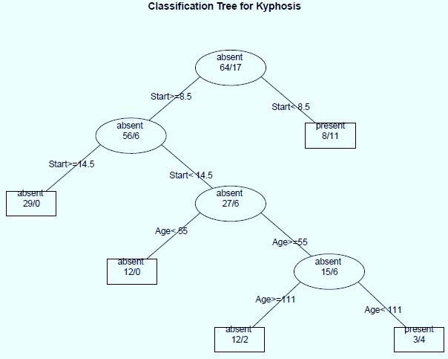
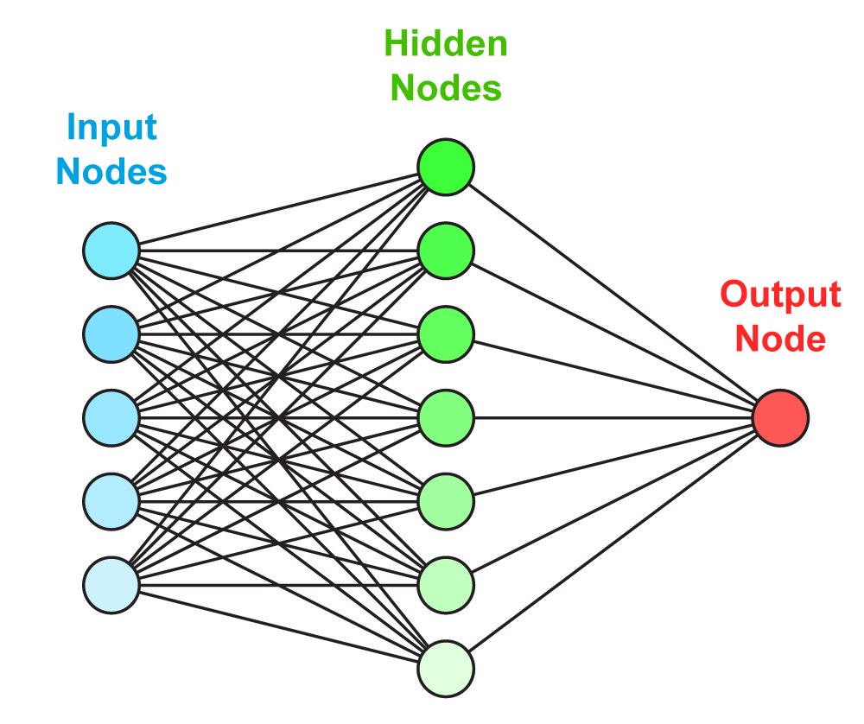
Life Event Models
Predict births, marriages, moves, etc.
Provide better services to members/customers
Neural Networks
Logistic regression
Classification Trees
Random Forests
Ensembles

Slide 15
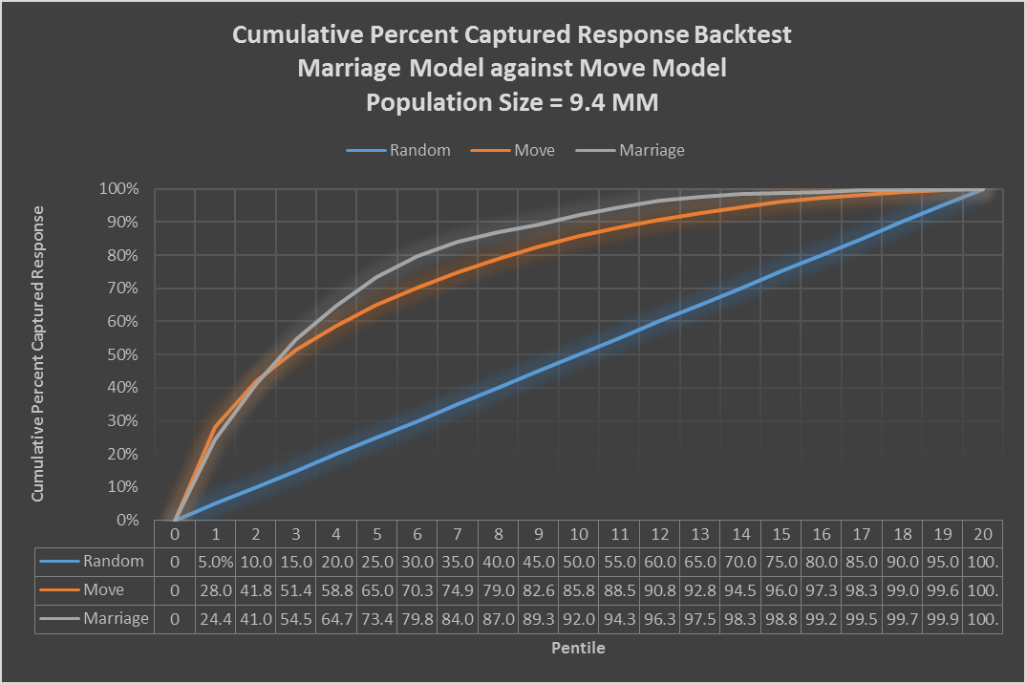
Marriage Model
Predict which customers will get married in the next 6 months
Binary Response
Ensemble
Neural Network
Logistic Regression
Propensity Scores
Posterior Probabilities
Group by Pentile (20)
Performance Monitoring
R-packages – GLM, neuralnet, nnet

Slide 16
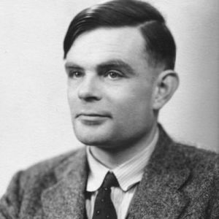
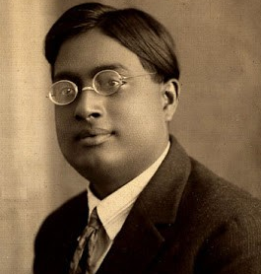
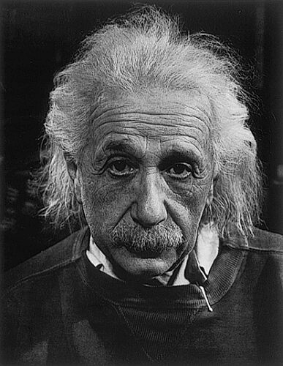
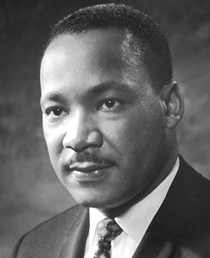
Who’s who in India?
Which of the following has a street at VIT named after him?
Alan Turing
Satyendra Nath Bose
Albert Einstein
Martin Luther King, Jr.

Slide 17
www.humalytica.com
http://www.amazon.com/Jeffrey-Strickland/e/B00IQ69QZK/
http://www.lulu.com/spotlight/strickland_jeffrey

